Slide 1




FRONT-END DEVELOPMENT
ASSIGNMENT 1 TEMPLATE
STUDENT NAME: Hariharan S
YEAR: II
COLLEGE CODE: 1455
COLLEGE NAME: Tagore College of Arts And Science.
DEPARTMENT: Computer Science
SEMESTER: 4th Semester
ROLL NO: unm1455222407723
NMID: 614D89761591EB584744FC4BCEE6FE5F
DATE: 10/03/2026
PROJECT TITLE: HTML Structure for Event Registration
Assignment and Assumptions:
This project is a College Workshop Registration page designed to digitize student sign-ups for technical seminars. It provides a structured interface for users to view event logistics, submit personal data through a grouped form, and view a summary of participants in a table.
Assignment:
The objective of this assignment is to design and develop a Simple Event Registration Page utilizing a structured approach to front-end development. The application is built to manage the registration process for college-level technical seminars. The main tasks completed include:
Structural Architecture: Defining a clear hierarchy of information using HTML5
User Information Capture: Designing a multi-section form to collect personal, event, and college-specific data.
Data Organization: Implementing selection menus and radio buttons to standardize user responses.
Reporting Interface: Creating a static table to represent how registered participant data is displayed to administrators.

Slide 2
1.2.Purpose:
The objective is to master Semantic HTML and form structures. I aim to learn how to organize user inputs and display data clearly using tables and fieldsets.
Problem Statement:
Current event registration methods in academic environments often rely on physical paperwork or fragmented digital tools, which are prone to data entry errors and loss of information. This application addresses the need for a centralized, digital registration portal that streamlines the sign-up process, ensures all mandatory fields are captured, and provides an immediate visual summary of registered students
Expected Features:
1. Event Title and Description:
Title: College Workshop Registration
Description: To provide an intuitive platform for students to sign up for upcoming technical seminars, such as Java , python and c++ workshops.
2. Event Information & Registration Form Section:
This section serves as the core interaction point for the user, providing essential logistics and data entry fields.
Event Information: Displays the specific date (15-03-2026) and the physical location (Seminar Hall A) to the user.
Registration Form: A highly organized form using <fieldset> containers to group related information logically.
Personal Information: Captures the student's Name, Email, Phone number, and Date of Birth.
Event Selection: Offers a curated list of workshops (Java or Python) via a dropdown menu.
Additional Details: Allows students to specify their participation mode—either "Online" for remote access or "Offline" for in-person attendance.
Declaration: Includes a mandatory confirmation checkbox to ensure the user verifies the accuracy of their provided details.
Form Controls: Features a "Submit" button to process the registration and a "Reset" button to clear all inputs for fresh entry.

Slide 3
Example:
Registration Form – Example Filled Data Personal Information
Name: Hariharan S
Email: kumaravelat2005@gmail.com
Phone Number: 8056194886
Date of Birth: 26/10/2005
Gender: Male
3.3. Registered Participants Section
This section presents a clear, tabular view of student data, which is essential event coordinators to track attendance
| Name | Email | Phone |Event | Mode |
| Hariharan S | kumaravelat2005@gmaul.com |8056194885 | Java | Offline|
Example:
Name | Email | Phone | Event | Mode
Hraiharan S | kumaravelat2005@gmail.com | 8056194886 | Java | Offline
3.4. Footer Section:
The footer provides a professional closing to the page, offering support channels and legal ownership information
Example:
Contact Details(Organizer)
Name : Hariharan S
Contact Email: kumaravelat2005@gmail.com
Contact Number: +91 8056194886
Support Timings: 8:30 AM – 2:30 PM (Working Days Only)
Department: Department of Computer Science

Slide 4
Implementation Steps:
Requirement Analysis: Analyzed the registration needs to determine the necessary data fields and structural components.
Semantic Skeleton Construction: Built the page using HTML5 semantic tags, ensuring that the title (<h2>), informational text (<p>), and form sections were logically nested.
Form Development:
Implemented the <form> element with unique IDs for future scripting.
Utilized the <fieldset> and <legend> tags to create clear visual and structural boundaries between personal data and event preferences.
Applied specialized input types like type="email" and type="tel" to enable automatic browser-side validation and improve mobile keyboard layouts
Selection Logic: Created a <select> dropdown for workshop choices and used radio buttons (type="radio") with matching name attributes to ensure only one participation mode could be selected at a time.
Table Construction: Built a <table> with a defined header (<thead>) to display participant records
Footer Integration: Added contact details to mark the end of the page.
Technologies Used:
HTML5: Used to create the semantic structure and all form elements.
Browser-native Validation: Used for basic data verification through input attributes.

Slide 5
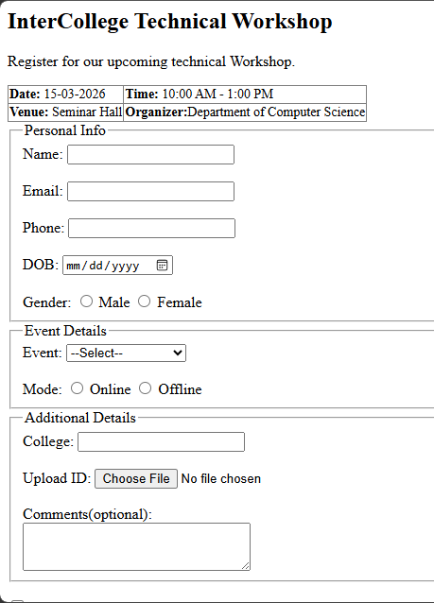
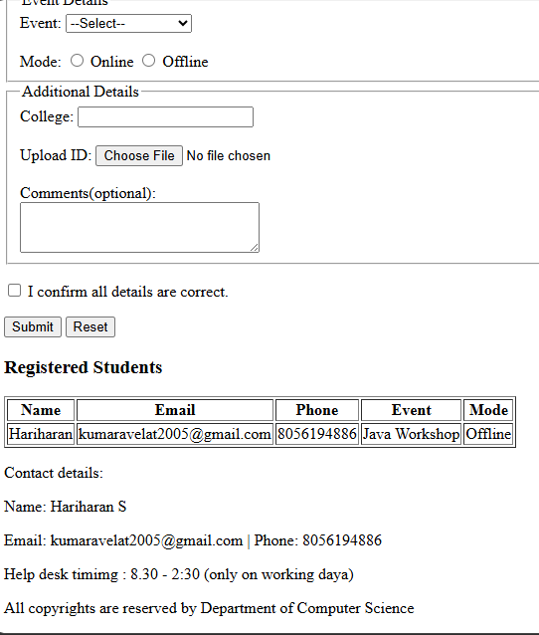
Output:
Learning Outcome:
Through this assignment, I learned how to create accessible web forms and how to group related data using semantic tags. I also gained a better understanding of how different input types improve the user experience on both desktop and mobile devices.
Conclusion:
The project successfully delivers a clean, functional HTML-based registration page. It effectively captures user data and provides a clear overview of the event, serving as a solid base for future styling and interactivity.

